Slide 1

Employee Performance Analysis Using Excel
PRESENTED BY: SATHIYA.M
REGISTER NO:312207875
DEPARTMENT: B.COM(A/F)
COLLEGE:THE QUAID-E-MILLETH COLLEG FOR MEN

Slide 2
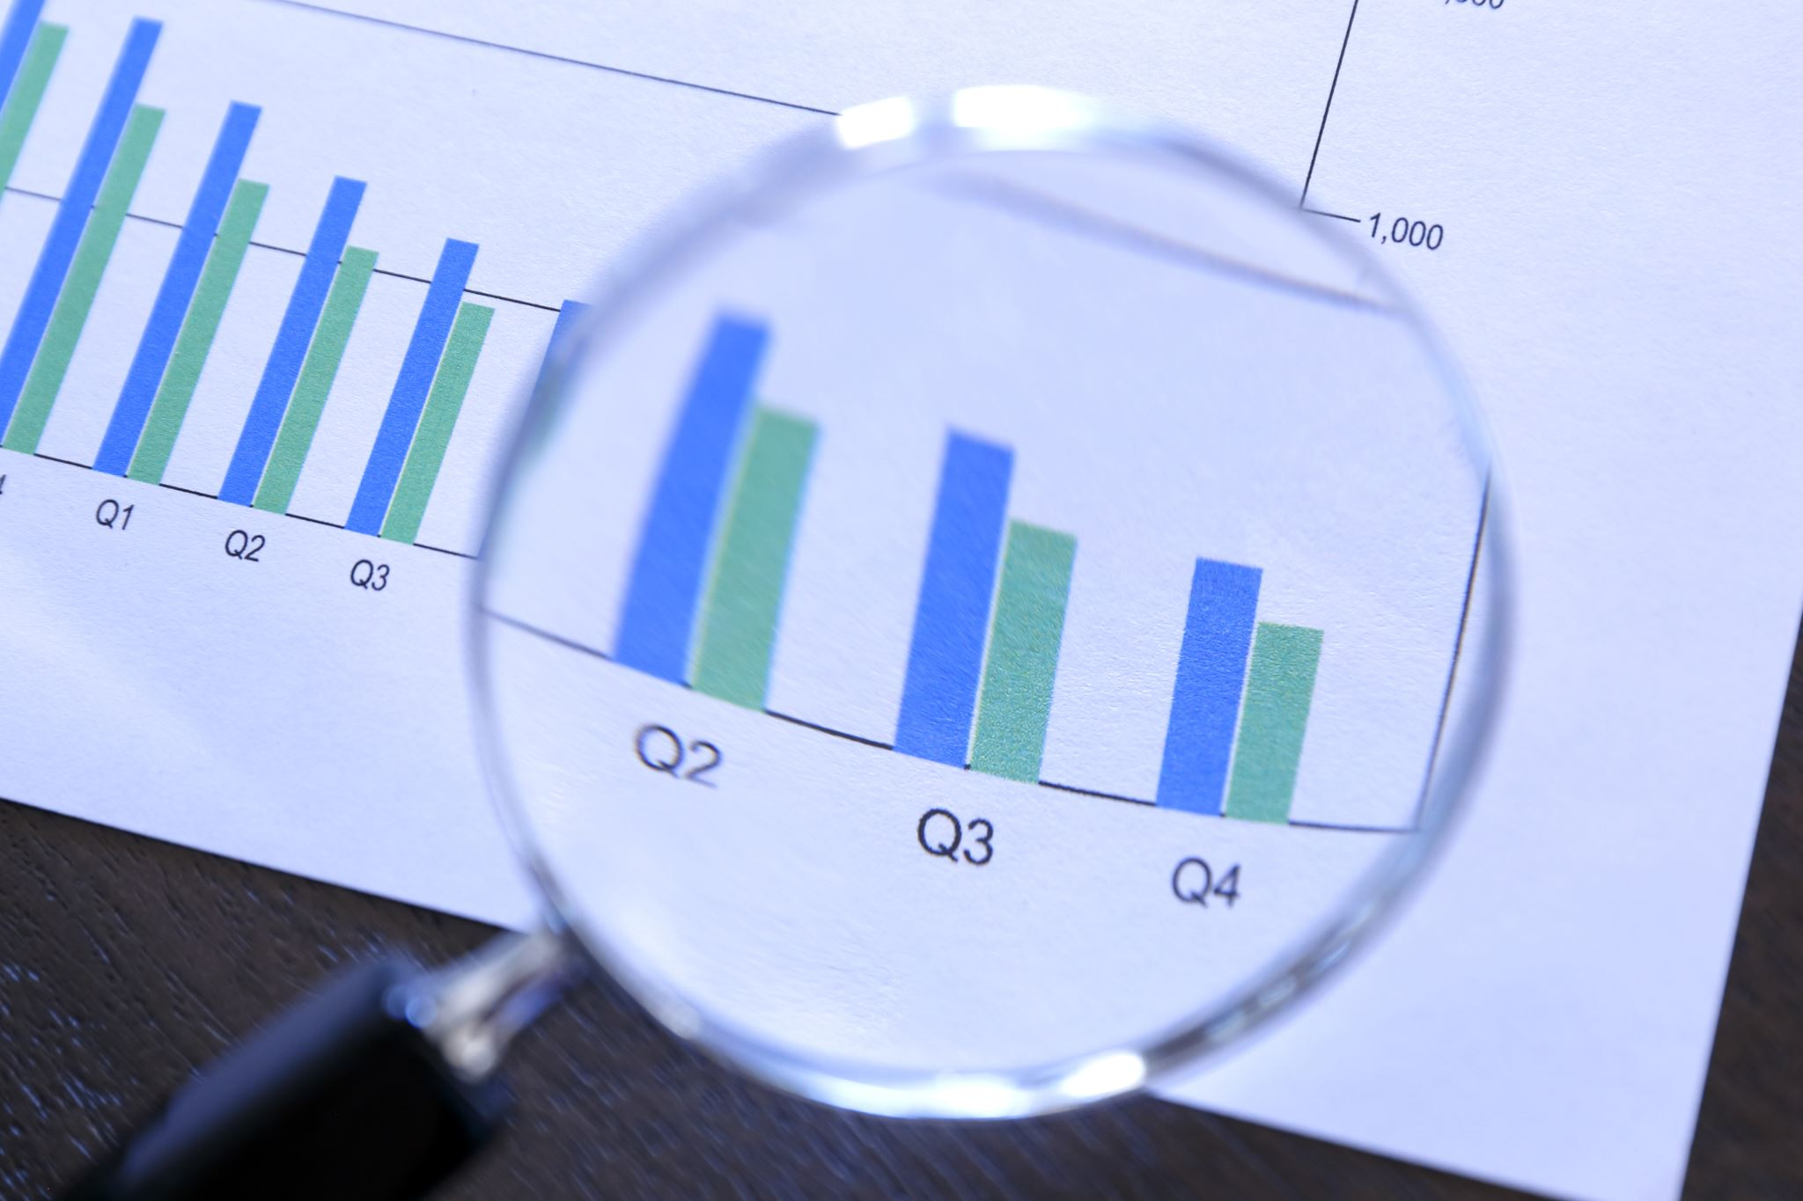
PROJECT TITLE
Employee Performance Analysis

Slide 3
AGENDA
1.Problem Statement
2.Project Overview
3.End Users
4.Our Solution and Proposition
5.Dataset Description
6.Modelling Approach
7.Results and Discussion
8.Conclusion

Slide 4

PROJECT STATEMENT
Employee performance is often inconsistent, leading to reduced productivity and missed goals. This can be due to factors like unclear expectations, lack of training, or ineffective communication. Employees may not be meeting performance targets or completing tasks efficiently. Employees may be dissatisfied with their roles or the company, leading to turnover. Employees may not be developing their skills or advancing in their careers. The organization may not be achieving its goals due to inadequate employee performance.

Slide 5

PROJECT OVERVIEW
Employee performance analysis involves evaluating various metrics such as productivity, efficiency, and output quality to assess individual and team performance. By leveraging data analytics, organizations can identify top performers, areas for improvement, and potential training needs. An employee data sheet is a paperwork form used by businesses to store information on employees such as their duties, contact information, and performance records. Use this Employee Data Sheet to gather contact details, notify employees of a new position, or keep track of performance in your company

Slide 6

END USERS
Human Resources professionals use performance analysis to design and implement training programs, compensation strategies, and performance management systems.
Managers use performance analysis to provide feedback to employees, identify development needs, and make informed decisions about promotions and salary adjustments.
Employees benefit from performance analysis by receiving feedback, identifying areas for improvement, and setting goals for professional growth.
Executive leaders use performance analysis to track overall organizational performance, make strategic decisions, and ensure alignment with business objectives.

Slide 7
OUR SOLUTION AND PROPOSITION
Employee performance analysis is critical for organizational success. It allows organizations to identify areas of improvement, optimize talent, and drive growth. Our solution provides a comprehensive and data-driven approach to performance evaluation. rewards like salary, stock options and bonuses. Employment benefits like paid time off, health insurance, retirement funds, parental leave and company-sponsored holidays. EVPs: Financial rewards like salary, stock options and bonuses. Employment benefits like paid time off, health insurance, retirement funds, parental leave and company-sponsored holidays.

Slide 8
DATASET DESCRIPTION
The data set contains data like age, gender, job satisfaction, environment satisfaction, education field, job role, income, overtime, percentage salary hike, tenure, training time, years in current role, relationship status, and more.
A data set is a collection of related data that is organized and stored for analysis or processing. Data sets can be used for many purposes, including Training and testing machine learning models Data visualization Research Statistical analysis Analytics Business intelligence Developing and testing applications

Slide 9

THE “WOW” IN OUR SOLUTION
Are unique and memorable experiences during the onboarding process that leave a lasting impression on new hires. These moments typically evoke positive emotions and establish a strong connection between the employee and the organization.

Slide 10
MODELLING APPROACH
A modeling approach is a way of using a particular type of model to study a scientific phenomenon. It can involve combining different methods and techniques, and the approach you take may depend on the problem you're trying to solve and the domain you're working in. Here are some examples of modeling approaches
Immuno-dynamics modeling
Statistical modeling
Integrated modeling method
Modeling instruction

Slide 11
RESULT AND DISCUSSION
In a research paper, the results section presents the findings of the study, while the discussion section interprets the results and explains their meaning. The results section should be objective and unbiased, without any analysis or interpretation of the data. The discussion section should not repeat the results, but instead put them in context and explain why they matter.
Before publishing or creating a poster, you can run the results and discussion sections by committee members and your chair to make sure they are congruent with your research purpose, objectives, hypothesis, and methods.

Slide 12
ANALYZING INDIVIDUAL EMPLOYEE PERFORMANCE
Gather relevant data from performance reviews, surveys, and performance management systems.
Analyze the collected data using statistical methods, identifying trends, patterns, and areas of strength and weakness.
Interpret the results to understand the individual employee's performance, identifying strengths, areas for improvement, and potential development needs.

Slide 13
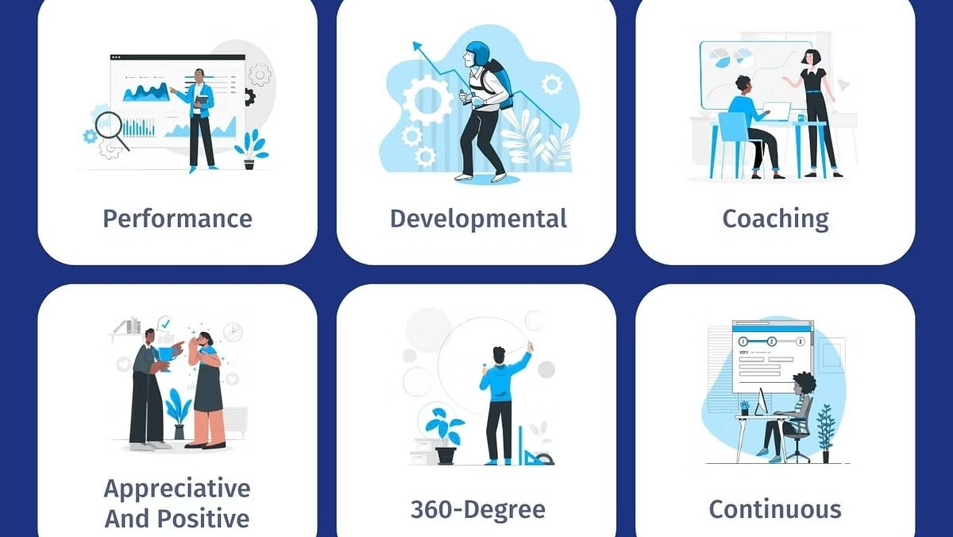
DEVELOPMENT OPPORTUNITIES
Provide
Provide employees with constructive feedback on their performance, highlighting strengths and areas for improvement.
Create
Create individualized development plans based on performance analysis results, focusing on addressing weaknesses and building skills.
Offer
Offer relevant training programs and coaching sessions to support employee growth and development in identified areas.

Slide 14
CONCLUSION
By implementing a robust performance analysis framework, organizations can gain valuable insights into their workforce, optimize operations, and drive continuous improvement. Regular monitoring, data-driven decision making, and a focus on employee development are crucial for maximizing workforce performance and achieving business success.

Slide 15

THANK YOU

